Slide 1
Data Movement Using ADF: Patterns and Best Practices
Shirley Wang, ADF PM, shwang@microsoft.com
Linda Wang, ADF PM, jingwang@microsoft.com

Slide 2
Agenda Topics
Key data movement patterns
Customer wins
Capabilities & best practices
Roadmap

Slide 3




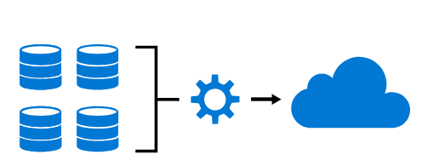
Azure Data Factory
Hybrid data integration service for enabling code-free ETL
Industry leading data ingestion
Visual
No Code
Hybrid
Pay only for what you use
Managed SSIS
Productive & trusted hybrid data integration service that simplifies ETL with any data, from any source, at scale.

Slide 4


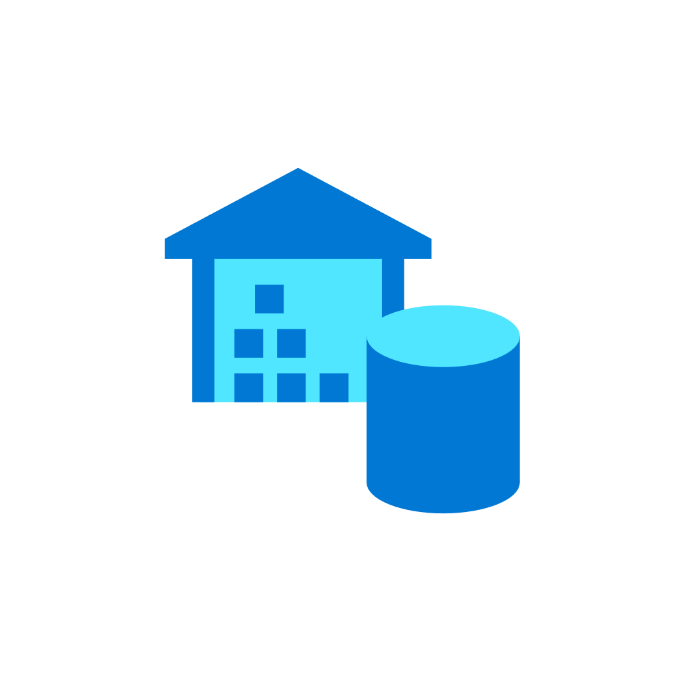




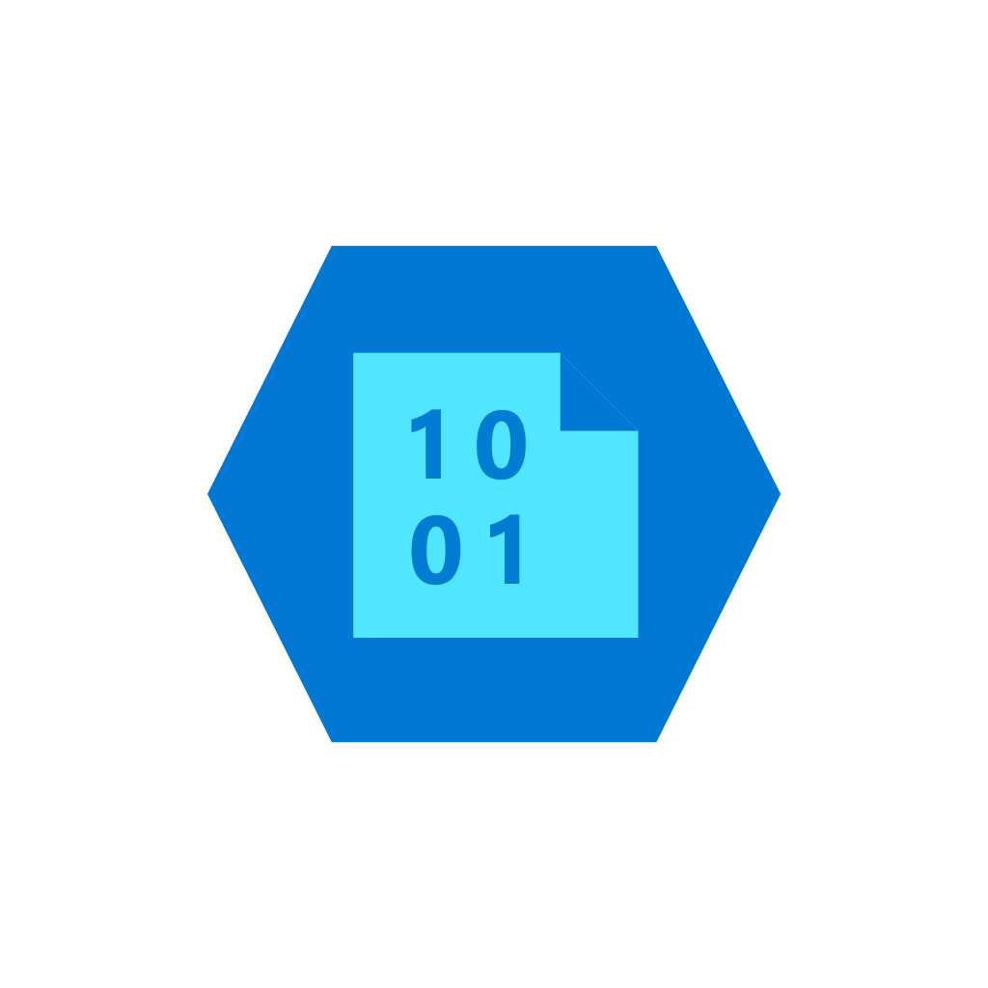
Modern Data Warehouse (MDW)
INGEST
PREPARE
TRANSFORM
& ENRICH
SERVE
VISUALIZE
On-premises data
Oracle, SQL,, Teradata, fileshares, SAP
Azure
Data Factory
Azure
Data Factory
Azure
Data Factory
Azure
SQL Data
Warehouse
Power BI
Cloud data
Azure, AWS, GCP
Azure
Databricks
Azure
Databricks
STORE
SaaS data
Salesforce, Dynamics
Azure Data Lake Storage Gen2
Data Pipeline Orchestration & Monitoring
Azure Data Factory

Slide 5

Analytics for data-driven apps
INGEST
PREPARE
TRANSFORM
& ENRICH
SERVE
On-premises data
Oracle, SQL,, Teradata, fileshares, SAP
Azure
Data Factory
Azure
Data Factory
Azure
Data Factory
Cosmos DB
[SaaS] App
Browser/Device
Cloud data
Azure, AWS, GCP
Azure
Databricks
Azure
Databricks
STORE
SaaS data
Salesforce, Dynamics
Azure Data Lake Storage Gen2
Data Pipeline Orchestration & Monitoring
Azure Data Factory

Slide 6
ADF momentum…by the numbers
7K
70%
FY19 ADF billable customer - 77% YoY growth
Billable
customers
of Azure HIPO customers use ADF
500
MILLION
20
PB
Activity runs per month
Data moved per month
Microsoft Confidential

Slide 7
Data Movement Patterns
Ingest data using ADF to bootstrap your analytics workload
KEY SCENARIO | WHY ADF
Data migration for data lake & EDW Big data workload migration from AWS S3, on-prem Hadoop File System, etc EDW migration from Oracle Exadata, Netezza, Teradata, AWS Redshift, etc | Tuned for perf & scale: PBs for data lake migration, tens of TB for EDW migration Cost effective: serverless, PAYG Support for initial snapshot & incremental catch-up
Data ingestion for cloud ETL Load as-is from variety of data stores Stage for data prep and rich transformation Publish to DW for reporting or OLTP store for app consumption | 80+ built-in connectors: file stores, RDBMS, NoSQL. Hybrid connectivity: on-prem, other public clouds, VNet/VPC Enterprise grade security: AAD auth, AKV integration Developer productivity: code-free authoring, CICD Single-pane-of-class monitoring & Azure Monitor integration

Slide 8
Online (ADF) or Offline (Data Box)?
Key considerations: (1) size of data, (2) network bandwidth, (3) migration window
The following table assumes 2-weeks as the target migration window
Data size \ bandwidth | 50 Mbps | 100 Mbps | 200 Mbps | 500 Mbps | 1 Gbps | 10 Gbps
1GB | 2.7 min | 1.4 min | 0.7 min | 0.3 min | 0.1 min | 0.0 min
10GB | 27.3 min | 13.7 min | 6.8 min | 2.7 min | 1.3 min | 0.1 min
100GB | 4.6 hrs | 2.3 hrs | 1.1 hrs | 0.5 hrs | 0.2 hrs | 0.0 hrs
1TB | 46.6 hrs | 23.3 hrs | 11.7 hrs | 4.7 hrs | 2.3 hrs | 0.2 hrs
10TB | 19.4 days | 9.7 days | 4.9 days | 1.9 days | 0.9 days | 0.1 days
100TB | 194.2 days | 97.1 days | 48.5 days | 19.4 days | 9.5 days | 0.9 days
1PB | 64.7 mo | 32.4 mo | 16.2 mo | 6.5 mo | 3.2 mo | 0.3 mo
10PB | 647.3 mo | 323.6 mo | 161.8 mo | 64.7 mo | 31.6 mo | 3.2 mo
Online | Offline

Slide 9
Customer Wins

Slide 10



Case #1: Large ISV in big data analytics
Highlight: migrated 2PB data from S3→Blob in <11 days
Customer challenges
Existing analytics platform is deployed on-prem or on AWS; some customers desire to migrate from AWS to Azure
Goal is to migrate data lake into Azure Storage Blob and perform analytics in Azure (custom-coded Spark)
Minimal migration duration, max load throughput
Initial load
1.9 PB, 269 million files
Avg. throughput: 2.1 GBytes/sec
Incremental top-up
221 TB, 26 million files
Avg. throughput: 3.6 GBytes/sec
AWS-Azure public peering
AWS S3 store
Azure Storage

Slide 11

Case #2: APAC unicorn in transportation service
Highlight: migrated ~1PB from S3→Blob over 10Gbps private link
Customer challenges
Near-term: tactical lift-and-shift of existing analytics workload from S3 into Azure
Over time modernize workload using Azure Data services
Data security in transit: data should traverse through private channel instead of public Internet
Optimize network egress charges out of AWS by going through AWS Direct Connect
Migration Statistics
941 TB, 40 million files
Avg. throughput: 787 MBytes/sec
AWS S3 store
Private Peering
Azure Storage

Slide 12
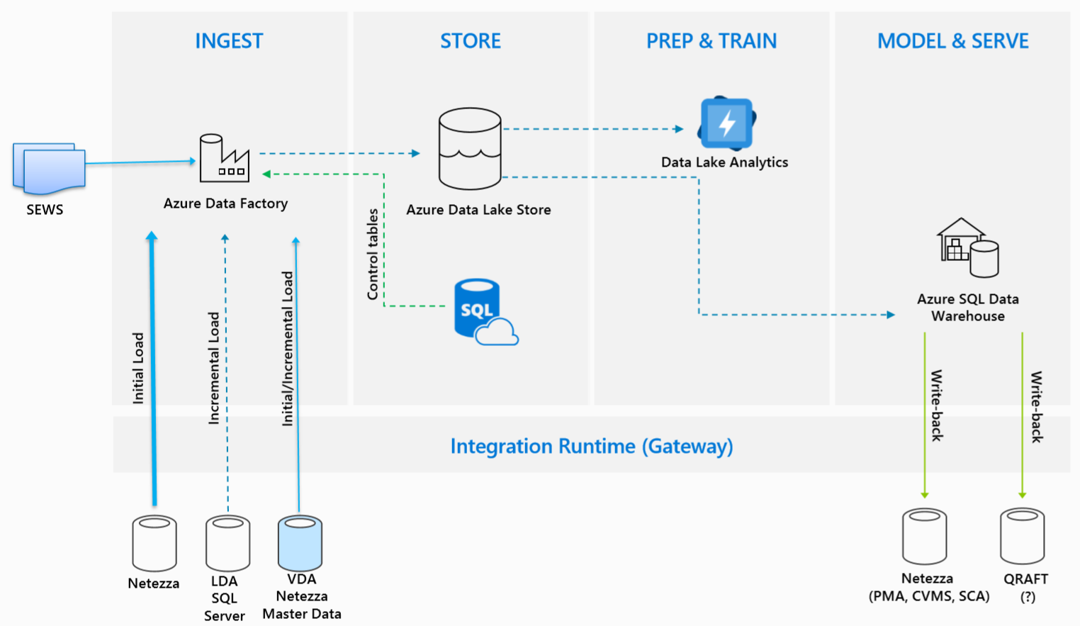
Case #3: Manufacturing company in WE
Highlight: migrate 25TB on-prem Netezza to ADLS
Customer situation
Standardize on an enterprise-wide analytics solution for processing telematics & sensor data
Follows typical MDW pattern; start with lake hydration from on-prem Netezza
Designated migration window between 18:00-08:00 from Monday to Friday
Limit overhead on Netezza: max 8 concurrent db connections
Migration Statistics
25 TB, 17 tables in total
Total migration duration: ~3 weeks

Slide 13
Case #4: Large retailer in UK
Business Requirements
Building a Modern Multi-Platform DW that brings together silos of data across BUs into a central data lake
Higher granularity and lower latency: no redundant extract
Process at much data as possible where it lands: use Azure fabric to scale resources
Better perf and scale with elasticity to deal with big data; do not want to be in the business of managing infrastructure
Fit-for-purpose tools for transformation and analytics that supports a wide spectrum of personas (data engineer, data scientists, data integrator)
30
Projects
2M+
USD
Running in production
Revenue per month
Microsoft Confidential

Slide 14



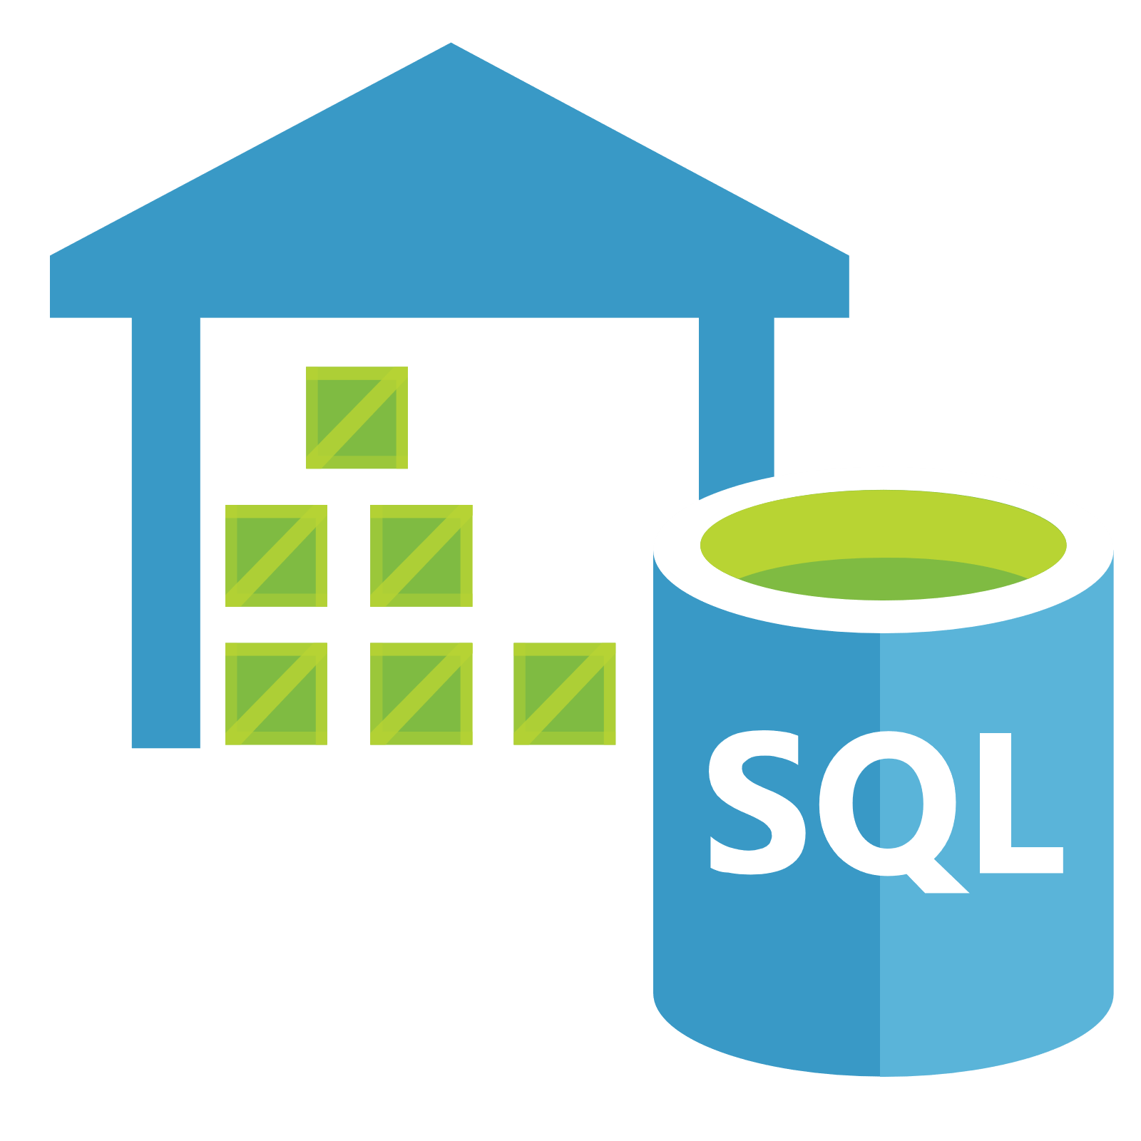


Solution Architecture
Ingestion & orchestration
Data Factory
SAP BW
DQ & Delta processing
Apply business logic
Control Channel
SFTP
PBI
Public Internet
Business Specific Folder
API App
Landing Folder
Main Folder
Self-hosted IR on-prem
SQL DW
AAS
Extraction
Self-hosted IR on Azure VM
Corporate Firewall Boundary

Slide 15

Solution Architecture (future)
Ingestion & orchestration
Data Factory
SAP BW
Control Channel
DQ & Delta processing
Apply business logic
PBI
SFTP
Landing Folder
Main Folder
Business Specific Folder
Express Route
(Private Peering)
API App
Azure Integration Runtime
SQL DW
AAS
Extraction
Corporate Firewall Boundary

Slide 16
Technical Considerations

Slide 17
Build Your Solution – Process
Assess
Functional POC
Performance POC
Deploy to Pre-RPOD and PROD
Understand the scenario and the workload:
What are the source and sink stores? Which format? (connectivity)
What is the network security requirement? (network)
One-time historical or incremental copy? (data loading pattern)
What is the data volume? (scale)
How many objects (tables/files) and what is the size distribution? (scale)
Identify key criteria:
Security requirement
Performance expectation
Special need
Can ADF meet these requirements?

Slide 18
Breadth of Connectivity

Slide 19
80+ Built-In Connectors
Support read & write
Support read only
Azure (15) | Database & DW (26) |  | File Storage (6) | File Formats (5) | NoSQL (3) | Services & Apps (28) |  | Generic (4)
Blob Storage | Amazon Redshift | Oracle | Amazon S3 | AVRO | Cassandra | Amazon MWS | Oracle Service Cloud | HTTP
Cosmos DB – SQL API | DB2 | Phoenix | File System | Delimited Text | Couchbase | CDS for Apps | Paypal | OData
Cosmos DB – MongoDB API | Drill | PostgreSQL | FTP | JSON | MongoDB | Concur | QuickBooks | ODBC
ADLS Gen1 | Google BigQuery | Presto | Google Cloud Storage | ORC |  | Dynamics 365 | Salesforce | REST
ADLS Gen2 | Greenplum | SAP BW Open Hub | HDFS | Parquet |  | Dynamics AX | SF Service Cloud
Data Explorer | HBase | SAP BW MDX | SFTP |  |  | Dynamics CRM | SF Marketing Cloud
Database for MariaDB | Hive | SAP HANA |  |  |  | Google AdWords | SAP C4C
Database for MySQL | Impala | SAP Table |  |  |  | HubSpot | SAP ECC
Database for PostgreSQL | Informix | Spark |  |  |  | Jira | ServiceNow
File Storage | MariaDB | SQL Server |  |  |  | Magento | Shopify
SQL Database | Microsoft Access | Sybase |  |  |  | Marketo | Square
SQL Database MI | MySQL | Teradata |  |  |  | Office 365 | Web Table
SQL Data Warehouse | Netezza | Vertica |  |  |  | Oracle Eloqua | Xero
Search Index |  |  |  |  |  | Oracle Responsys | Zoho
Table Storage

Slide 20
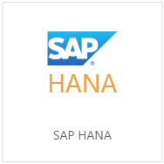
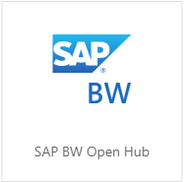
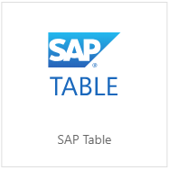
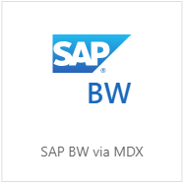
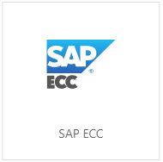
SAP Data Integration - Bring SAP data into Azure
LOAD FROM* | APPLICABLE CONNECTORS | CONNECTOR CAPABILITIES
SAP HANA |  | SAP HANA: Information models & Row/Column tables
SAP BW |  | SAP BW Open Hub: Open Hub Destination w/ DSO, InfoCube, MultiProvider, DataSource, etc SAP Table: Transparent/Pooled/Cluster Table & View SAP BW via MDX: Exploratory via MDX for InfoCubes, QueryCubes
SAP ECC |  | SAP Table: ECC, S/4HANA, Business Suite; Transparent/Pooled/Cluster Table & View SAP ECC: ECC, OData entities exposed via SAP Gateway (BAPI, ODP)
^{new}
^{new}
* Orthogonally, customer may already leverage SAP utilities to flow the same data across systems, e.g. ECC → HANA/BW.

Slide 21
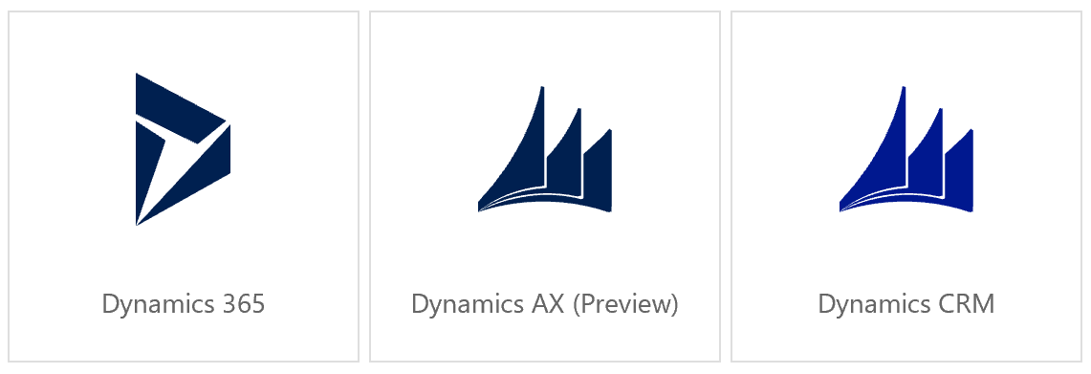
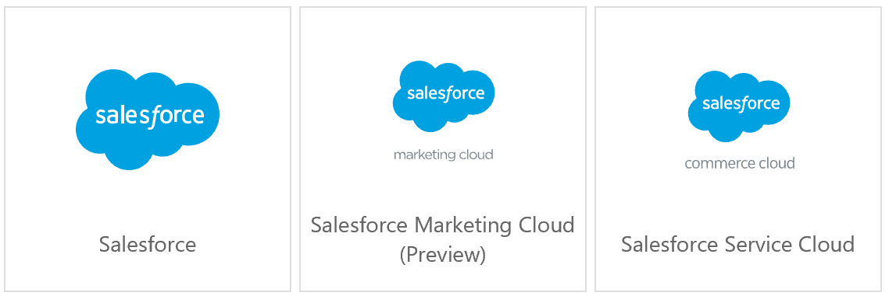
Popular SaaS: Dynamics and Salesforce
Rich Dynamics assets support
Dynamics 365 for Sales, Customer Service, Field Service, Finance and Operations, Project Service Automation, Marketing
Dynamics CRM 2015/2016/Online
Dynamics AX
Data Access @ Scale
Batch data extraction/write built on top of Dynamics XRM tooling and OData service
Rich Salesforce assets support
Any Salesforce editions (Developer, Professional, Enterprise, and Unlimited)
Any Salesforce env. (production, sandbox, and custom domain)
Salesforce objects and reports
Data Access @ Scale
Batch data extraction/write built on top of Salesforce bulk/REST APIs.

Slide 22
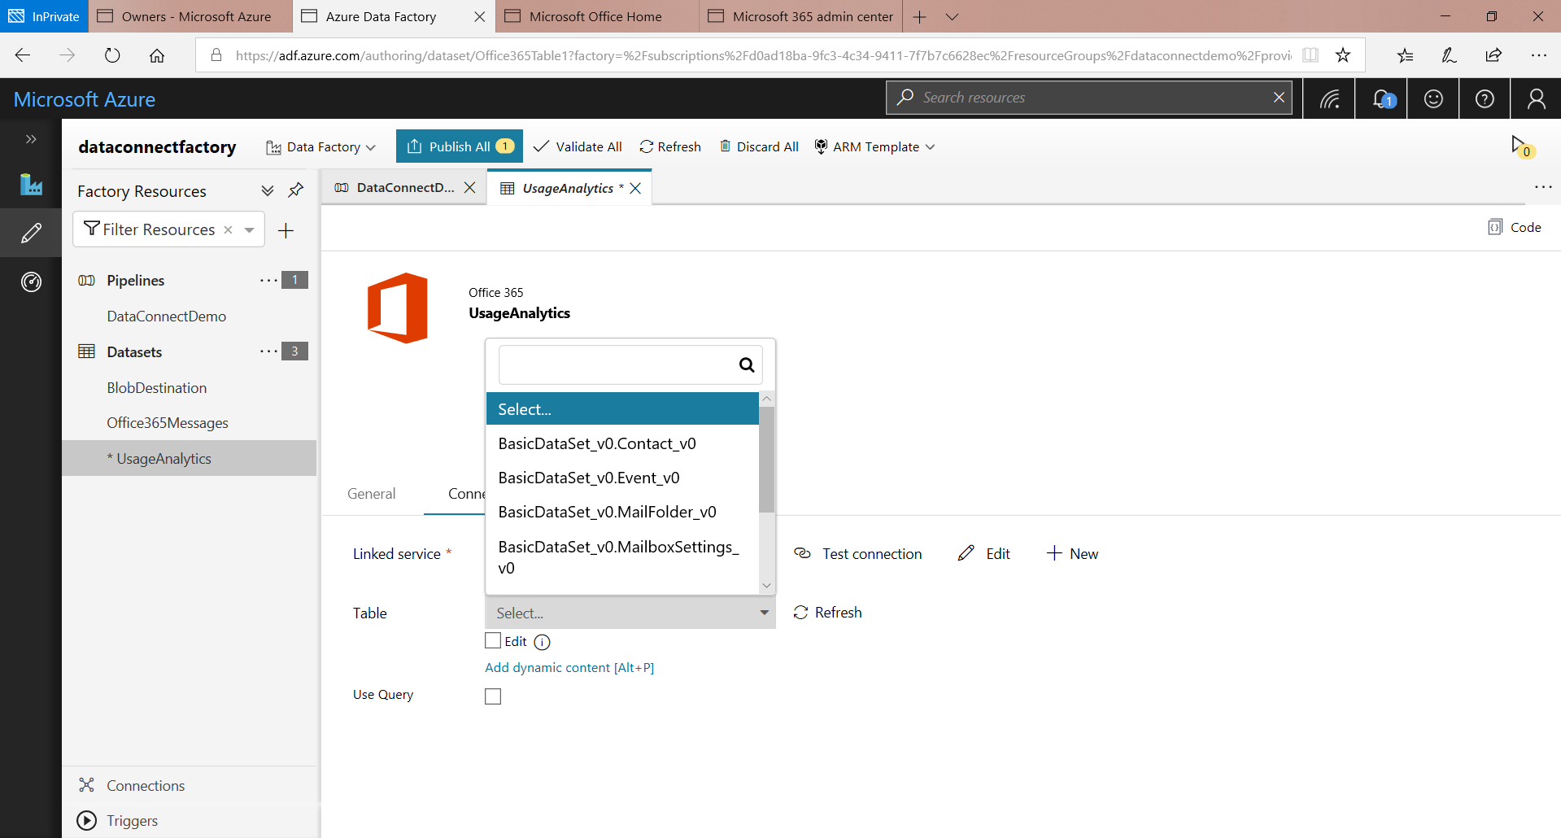
Microsoft Graph data connect
Microsoft 365 Data access @ scale for analytics and AI
Data Access @ Scale
Bulk data extraction for entire tenant rather than real-time API based access
Secured access
Tenant admin consent process
Row and column level scoping with advanced filtering capability
Available datasets
Address book contacts
Calendar events
Email messages
Mailbox settings

Slide 23
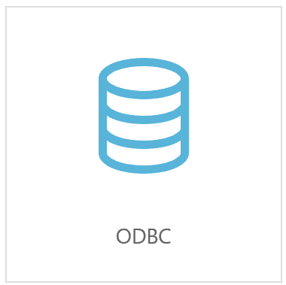
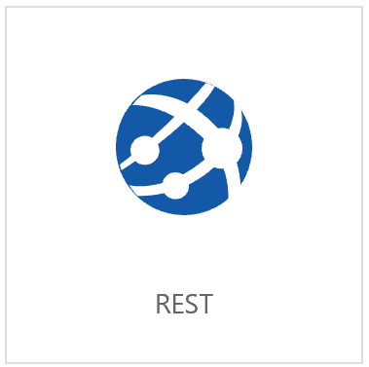
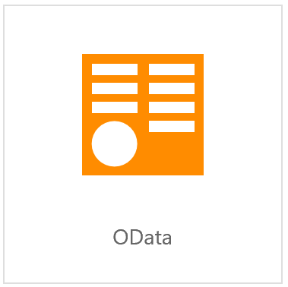
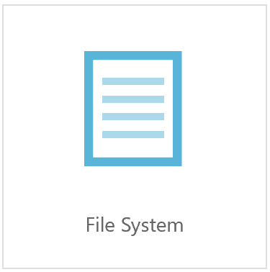
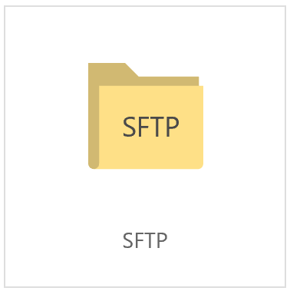
Connector “Extensibility”
Not in the supported list? No worries:
DATA STORE TYPE | SOLUTION
Database/DW | Use generic ODBC connector for both read and write
SaaS apps | Check if it provides RESTful APIs, use generic REST connector Check if it has OData feed, use generic OData connector
Others | Check if you can load to any supported data stores as staging first, e.g. File/FTP/SFTP/S3, then let ADF pick up from there | .....

Slide 24
Network Configuration

Slide 25


On-prem connected to Azure through public internet
Self-hosted IR deployed on premises
Data Factory
Self-hosted IR
on premises
Data stores
Azure Storage
Azure SQL DB
Azure SQL DW
HDInsight
Databricks
VNet ACL
Corporate Firewall Boundary

Slide 26

On-prem connected to Azure VNet through Express Route
Self-hosted IR deployed on Azure VM
Data Factory
Azure Storage
Azure SQL DB
Azure SQL DW
VNet ACL
VNet service endpoints
Express Route
(private peering)
Data stores
Self-hosted IR on Azure VM
HDInsight
Databricks
Corporate Firewall Boundary
Azure Virtual Network

Slide 27
Cloud-to-cloud private peering
Self-hosted IR deployed on Azure VM
Data Factory
Azure Storage
VNet ACL
VNet service endpoints
AWS S3 store
Direct Connect
Express Route
Private Peering
(router based)
Self-hosted IR on Azure VM
AWS VPC
Azure Virtual Network
AWS

Slide 28
Network Configuration Options
Self-hosted IR on Azure VM Data transfer via ER | De-facto choice for enterprises! Most secure Dedicated network BW → predicable perf
Self-hosted IR on prem Data transfer via public internet | Well suited for ISVs! Low friction and effort
In future use Azure IR! (VNet support ^{upcoming})
On-prem to cloud
Azure IR Data transfer via public internet | Well suited for most scenarios Low friction and effort
Self-hosted IR on Azure VM Data transfer via private peering | Most secure Dedicated network BW Reduce AWS egress charge
Cloud to cloud
In future use Azure IR! (VNet support ^{upcoming})

Slide 29
Security

Slide 30
Designing Password-Less Pipelines
AUTHENTICATION
CREDENTIAL MANAGEMENT
Authenticate to Azure data services using Managed Identify (aka MSI) or Service Principal
Authenticate to external data stores using basic auth, key-based auth, or Windows auth, where applicable
Recommended: store credentials in Azure Key Vault and reference key vault secret from ADF
Alternatively: supply credential inline in Linked Service and ADF will encrypt it at rest:
Cloud creds are encrypted by ADF-managed certs
On-prem creds are encrypted by Windows DPAPI

Slide 31
Data Security
DATA ENCRYPTION IN TRANSIT
DATA ENCRYPTION AT REST
Data is transferred through secure channel HTTPS/TLS (V1.2) if data store supports HTTPS or TLS.
Data is encrypted at rest by leveraging data store’s encryption mechanisms:
Transparent Data Encryption (TDE) in Azure SQL Data Warehouse and Azure SQL Database
Storage Service Encryption (SSE) for Azure Storage
Automatic encryption for ADLS
And so on

Slide 32
Data Loading Patterns

Slide 33
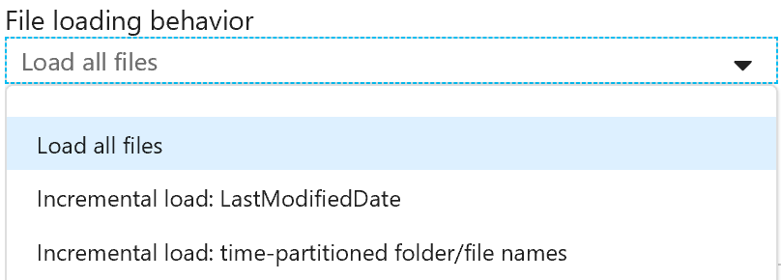
Retrieve Data from File Sources
In each copy activity execution, ADF in parallel copy/parse multiple files (determined by “parallel copy”) under the specified path across Azure IR Data Integration Units or Self-hosted IR nodes; within each file, data is always handled by chunks concurrently as well.
INCREMENTAL DATA PATTERN |  | SUGGESTED CONFIGURATIONS
1 | Folders/files with date/time in name e.g. path: root/folder/2019/07/12 file name: <prefix>_20190712_<suffix> | Dynamic folder/file/wildcard* + tumbling window trigger root/folder/@{formatDateTime(pipeline().parameters.windowStartTime, 'yyyy/MM/dd’) *_@{formatDateTime(pipeline().parameters.windowStartTime, 'yyyyMMdd’)_*
2 | Identify newly created/updated files by last modified time e.g. between 2019/07/12-2019/07/13 | Dynamic last modified time* tumbling window trigger modifiedDatetimeStart: @pipeline().parameters.windowStartTime modifiedDatetimeEnd: @pipeline().parameters.windowEndTime
* When using wildcard (except prefix for S3/Blob) or last modified time, note all files’ metadata are scanned under the specified path. Narrow down the path whenever applicable to save enumeration cost.

Slide 34

Retrieve Data from Non-file Sources (DB/DW, NoSQL, SaaS)
In each copy activity execution, ADF issue the specified query to source to retrieve the data.
Source data
Single Copy Activity execution
e.g. set Parallel Copy = 4
......
Out-of-box optimization for
Oracle ^{new}, Teradata ^{new}, Netezza ^{upcoming}, SAP Table ^{new}, SAP BW via Open Hub:
Built-in parallel copy by partitions to boost performance for large table migration/ingestion, similar as Sqoop.
Options of range partition and native partition mechanism per data store.
C1 | C2 |  | PartitionCol
… | … | … | 10000
… | … | … | 10001
… | … | … | …
… | … | … | 30000
… | … | … | 30001
… | … | … | …
… | … | … | 50000
… | … | … | 50001
… | … | … | …
… | … | … | 70000
… | … | … | 70001
… | … | … | …
… | … | … | …

Slide 35
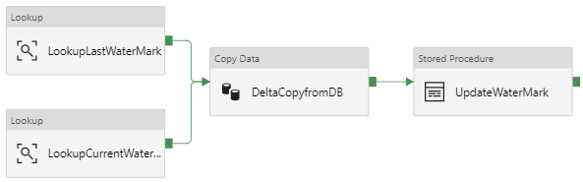
Retrieve Data from Non-file Sources (DB/DW, NoSQL, SaaS)
INCREMENTAL DATA PATTERN |  | SUGGESTED CONFIGURATIONS
1 | Data has timestamp column e.g. last modified time | Dynamic query + tumbling window trigger → Copy Data Tool SELECT * FROM MyTable WHERE LastModifiedDate >= @{formatDateTime(pipeline().parameters.windowStartTime, 'yyyy/MM/dd’) AND LastModifiedDate < @{formatDateTime(pipeline().parameters.windowEndTime, 'yyyy/MM/dd’)
2 | Data has incremental column e.g. ID (high watermark) | Control table/file + high watermark → solution template
3 | Data is small in size e.g. dimension data | Full copy and overwrite → Copy Data Tool
4 | Source has change tracking | Support for Azure SQL DB or SQL Server. Leverage Change Tracking by using sys.change_tracking_tables as high watermark value → solution template
Get old watermark
Update watermark
Copy delta
Get new watermark

Slide 36
Write Data to File Sinks
KEY CONSIDERATIONS | SUPPORTED CONFIGURATIONS AND SUGGESTION
Understand the write behavior | Sink folder: auto create if not exists Sink files: overwrite if exists; explicitly configure file name when generating single file for idempotency upon reruns
Options for copying from file source | Preserve hierarchy – most widely applicable and performant Merge to single file - less performant as cannot use file level write parallelism Flatten the folder structure – rare
Incremental | Partition by date/time to ease subsequent processing/consumption E.g. root/raw/data/@{formatDateTime(pipeline().parameters.windowStartTime, 'yyyy/MM/dd’)

Slide 37
Write Data to Non-file Sinks (DB/DW, NoSQL, SaaS)
KEY CONSIDERATIONS | SUPPORTED CONFIGURATIONS AND SUGGESTION
Choose the write behavior based on need | Append Default behavior for large majority of the connectors. Idempotentcy for reruns upon failure or as needed: pre-copy script to delete the partial data OR use upsert instead.
 | Upsert Built-in support connectors like Cosmos DB, Salesforce, Dynamics, etc. Others e.g. SQL: Load to staging table then use Stored Proc to do merge – performant batch operation, esp. suggested for large data. Invoking Stored Proc during copy – row by row operation, only applicable to small data.
 | Overwrite Pre-copy script to truncate table
Auto sink table creation | For Azure SQL DB/SQL DW/SQL MI/SQL Server ^{upcoming} to accelerate getting-started

Slide 38
Large Volume of Historical Load
Guidance:
Partition the data if:
You have large volume of historical data to copy.
OR you have need on managing the data migration windows.
Partitioning also reduces the risk of any unexpected issue.
Suggestion: make each partition to finish within few hours or within your expected loading window (more to cover in perf POC).
How to do partitioned load?
Control table + Lookup + ForEach w/ concurrency + Copy
File source: prefix, folder/file name
Non-file source: queries with filters to retrieve portion of data
Copy Pipeline
For Each partition…
Lookup
ForEach
Copy
Look up control table

Slide 39
Build Your Solution – Process
Assess
Functional POC
Performance POC
Deploy to Pre-RPOD and PROD
Choose a solution and conduct test on functionality:
Connectivity: test out built-in connectors – it can reach customer’s data store using the desired auth, can pull the expected data out and convert into the expected output format.
Network: set up Self-hosted IR per customer’s network topology as needed – onprem or in Azure VM
Security: secure credential handling, encryption in transit/at rest
Data loading pattern: choose the historical and incremental copy solution based on the workload/need
Get started:
Copy Data Tool to solve moderate need, or quickly get familiar with the config
Solution gallery for advanced scenarios beyond just copy activity, e.g. partitioned load, incremental load with high watermark

Slide 40
Build Your Solution – Process
Assess
Functional POC
Performance POC
Deploy to Pre-RPOD and PROD
Performance test and tuning to handle data at scale:
Pick a representative workload – throughput varies per data pattern
Obtain throughput baseline and compare to the performance expectation
Identify the copy bottlenecks
Tune configurations to optimize performance
Scale the configuration to entire dataset

Slide 41














Understand How ADF Copy Scales
Flexible control flow & scheduling to scale out.
(concurrency, partitions)
Command and Control
Azure Data Factory Service
Scheduling | Orchestration
…..
Data
Pipeline
Pipeline
Azure IR
Cloud
Cloud Data Stores
Azure Data Stores
On-prem
On-prem Data Stores
Self-hosted IR
Elastic managed infra to handle data at scale.
(configurable DIUs per run)
Customer managed infra with scaling options.
(powerfulness, concurrency)

Slide 42
Identity the Perf Bottleneck and Tune
POTENTIAL BOTTLENECK |  | CHECK | TUNING SUGGESTION
Within ADF | Self-hosted IR | ADF helper: Queueing time in activity monitoring IR metrics – CPU/memory utilization, queue length ^{upcoming}, queue time ^{upcoming} over time | Scale out by adding nodes to bring in more machine power and increase concurrent slots. Scale up by increasing concurrent slots if CPU/memory are low but queue length/time are big.
 | Azure IR | Esp. helpful for file-to-file copy and copy to Cosmos DB/Azure SQL DB. Default DIUs by “Auto” uses up to 32; max allowed is 256. | Default auto DIUs meets normal need. To get higher throughput, specify larger DIU to scale up each copy execution.
 | Copy service running on IR | ADF helper: Perf suggestion to optimize config in activity monitoring Perf reference # for single copy run covering popular pairs/patterns | Speed up w/ built-in parallel copies. Apply the suggested config. Partition the data and load concurrently by combining with control flow operations (examples).

Slide 43
Identity the Perf Bottleneck and Tune
POTENTIAL BOTTLENECK |  | CHECK | TUNING SUGGESTION
Outside of ADF | Source/sink data store | ADF helper: Perf suggestion in activity monitoring (e.g. Azure SQL DB/Cosmos DB) IO/CPU utilization on data store side | Upgrade data store tier Request higher IO limits
 | Network bandwidth | Esp. applicable for ExpressRoute, utilization on ER circuit | Scale up ER
Tips: if you have need on limiting the load on source/sink/network bandwidth, scale down the ADF config.

Slide 44
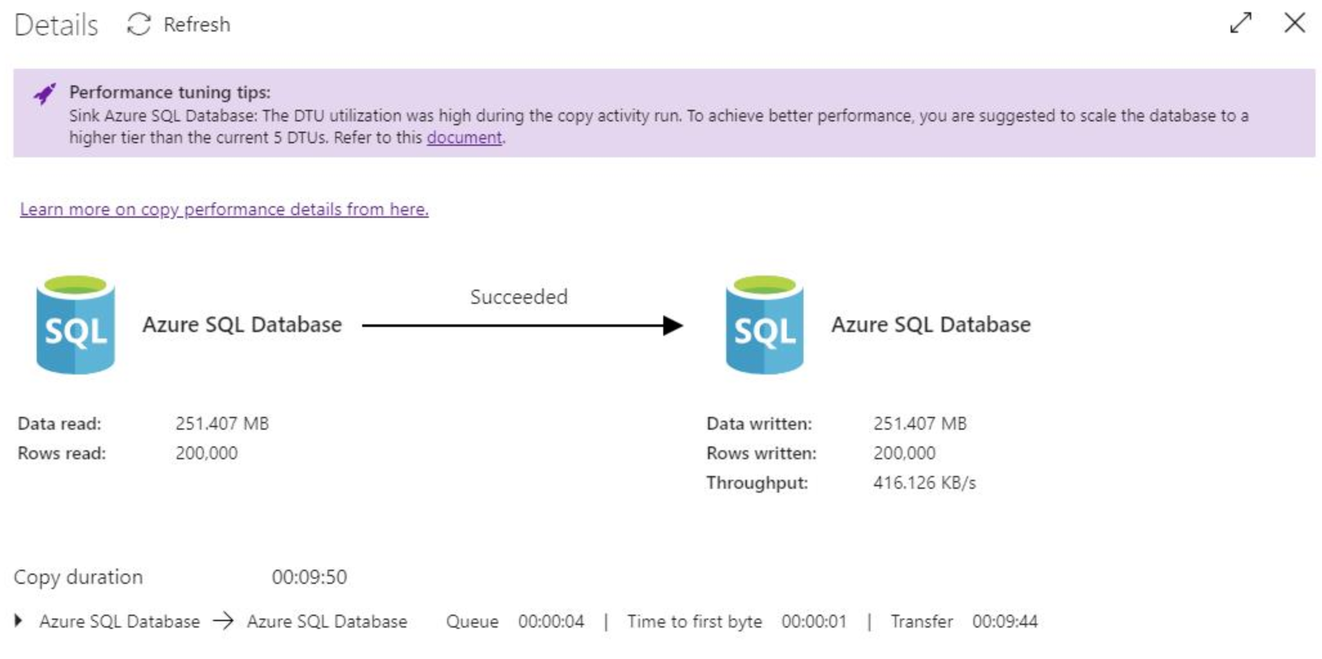
Performance Monitoring
Follow performance tips
More execution details, e.g.
Queue time – scale IR
Time to first byte – tweak query
More: used DIUs, used parallel copies, PolyBase true/false, staged copy w/ metrics, etc.

Slide 45
Data Lake Migration from AWS S3 → Azure Blob
Azure SQL DB
Control Table
Suggestions:
Choose appropriate partition size
Measure the throughput for single partition using a sample dataset
Partition size = [throughput]x1hr
Use S3 prefix to partition instead of using key+wildcard
Optimize single partition throughput
For Azure IR: set appropriate DIU setting (default=32 but can go up to 256)
For self-hosted IR: configure multiple nodes (up to 4)
Optimize aggregate throughput
Load multiple partitions concurrently
PartitionID | Prefix | Status
1 | booking/year=2019/month=01 | Success
2 | booking/year=2019/month=02 | Success
3 | booking/year=2019/month=03 | Failed
Update control table
Look up control table
For Each partition in control table…
Manual
Trigger
Lookup
ForEach
Copy
Stored Proc
Web
(send email)
Copy Pipeline
AWS S3
Azure Blob Storage
Source Bucket:
/bucket/<prefix>/files
Destination Container:
/container/<prefix>/files

Slide 46
Load & Process Data from Netezza → ADLS
Azure SQL DB
Control Table
PartitionID | TableName | QueryStmt | Status
1 | T1 | SELECT * from T1 where… | Success
1 | T1 | SELECT * from T1 where… | Success
1 | T2 | SELECT * from T2 where… | Success
2 | T3 | SELECT * from T3 where… | Failed
Update control table
Parent Pipeline
Copy & Process Pipeline per batch
For Each BatchID
For Each data portion in current batch…
Manual
Trigger
Lookup
Execute Pipeline
Lookup
Copy
DB Notebook
Stored Proc
Web
(send email)
Netezza
ADLS
Azure Databricks
T1
T2
…
T14
Raw Folder:
/YYYY/MM/DD/data.csv
Processed Folder:
/YYYY/MM/DD/files
Python scripts
(cleanse & aggregate)

Slide 47
Data Movement Investments (next 6mo)
VNet support for Azure IR: removes the need for installing/managing SHIR
IP whitelisting:
Restricted network access based on ADF static IP ranges
Service tag for ADF
Add ADF to “Trusted Azure Services”
Pause/resume: checkpoint copy progress and resume from last failure point
Data integrity: validate data integrity between source & destination
Better perf & scale for single copy:
Partitioned parallel for single large table (DIU>4 or >=2 SHIR nodes)
Partitioned parallel for single large file (DIU>4 or >=2 SHIR nodes)
Continue to expand built-in 1st class connectors
Azure Database for PostgreSQL as sink
Azure Database for MySQL as sink
Connectivity extensibility

Slide 48
Session Takeaways
ADF is well suited for both online data migration and data integration for cloud ETL scenarios
Action: understand key technical considerations and best practices
Action: take the knowledge and have a conversation with your customer about using ADF in their MDW workload

Slide 49
Additional Resources
Solution templates: https://docs.microsoft.com/en-us/azure/data-factory/solution-templates-introduction
Whitepapers: https://docs.microsoft.com/en-us/azure/data-factory/whitepapers
Have a challenging customer situation and need white glove help? Nominate your customer by filing a Engage Engineering request

Slide 50
Appendix

Slide 51
Data Migration Process
STEP | ACTIONS
Assess | Scope data assets to migrate Identify key migration criteria Conduct POC to test out approach Obtain throughput numbers Identify throttling bottlenecks
Plan | Request higher limits Tune configurations to optimize throughput Estimate load on source/destination and decide on approach Create schedule based on migration window
Migrate | Notify dependent teams/customers/partners Execute the migration! Monitor and rerun as necessary

